Slide 1

Spam Mail Detection
Guided By :- Deepak Gurao Sir.
Presented By :- Mahesh Lakade

Slide 2
Contents
Introduction
Problem Definition
OBJECTIVE
About dataset
Steps in Spam Mail Detection
Libraries
Techniques for Spam Mail Detection
Conclusion

Slide 3
Introduction
In today's globalized world, email is a primary source of communication. This communication can vary from personal, business, corporate to government. With the rapid increase in email usage, there has also been increase in the SPAM emails.

Slide 4
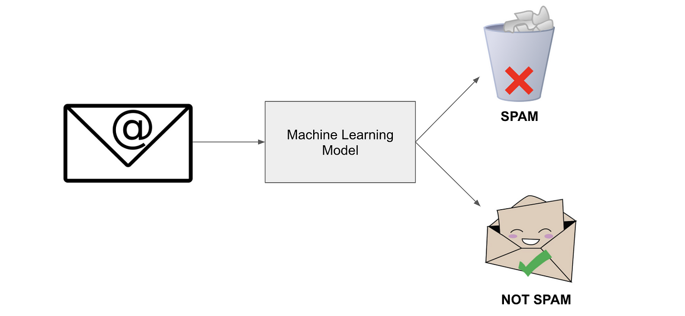
Problem Definition
Spam mail, often referred to as "spam" or "junk mail," is a term used to describe unwanted email messages sent in bulk to a large number of recipients, typically for commercial or malicious purposes.
We will explore and understand the process of classifying email as spam or not spam. This is called spam detection, and it is a binary classification problem.

Slide 5
OBJECTIVE
To compare the accuracy of the classifiers and introduces the best classifier for detecting mails.
We use different data mining techniques classifiers like Logistic Regression, SVM, and Random Forest to categorize a mail into spam.

Slide 6
About dataset
The Spam_Email_Detection_spam.csv dataset contains 5572 observations (rows) and 5 features (columns). The dataset contains 3 (Nan) values columns so that’s why we need to remove it and Then 2 nominal features (v1, v2) that were converted into factors with numerical value desginated for each level.
The purposes of this exercise to look into different features to observe their relationship, and to be used for spam mail detection.
Reference – www.kaggle.com

Slide 7
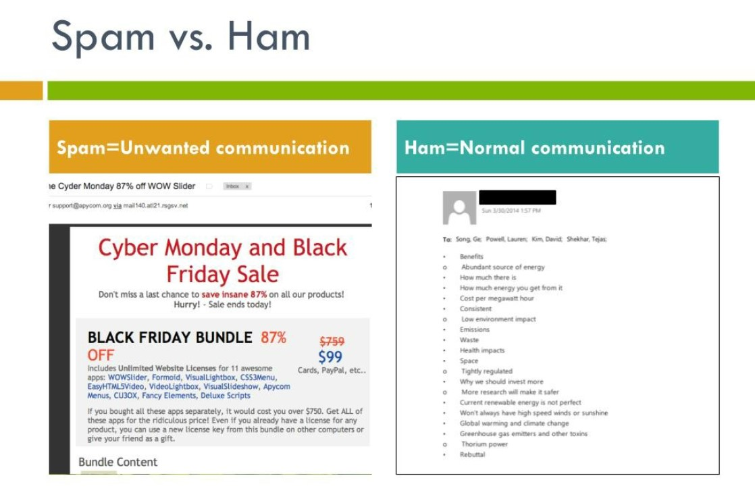
SPAM vs HAM Classification

Slide 8
Steps in Spam Mail Detection using Machine Learning :
Data Cleaning : Removal of duplicate entries, irrelevant features, and erroneous datapoints to enhance dataset integrity.
Handling Missing Values : Employed strategies such as mean imputation or removal of records with excessive missing values to ensure data completeness.
Feature extraction and selection
Model training and evaluation
Integration of the spam mail detection system

Slide 9
Libraries
NumPy:- NumPy is a library for the Python programming language, adding support for large, multi-dimensional arrays and matrices, along with a large collection of high-level mathematical functions to operate on these arrays. Moreover, NumPy forms the foundation of the Machine Learning stack.
Pandas:- Pandas is one of the tools in Machine Learning which is used for data cleaning and analysis. It has features which are used for exploring, cleaning, transforming and visualizing from data
Matplotlib:- Matplotlib is a low-level library of Python which is used for data visualization. It is easy to use and emulates MATLAB like graphs and visualization. This library is built on the top of NumPy arrays and consist of several plots like line chart, bar chart, histogram, etc.
Seaborn - Seaborn is a Python data visualization library based on matplotlib . It provides a high-level interface for drawing attractive and informative statistical graphics.

Slide 10
Popular Machine Learning Techniques for Spam Mail Detection
• Logistic Regression
• Support Vector Machines (SVM)
• Random Forests

Slide 11
Conclusion
Spam mails area unit used for spreading virus or malicious code, for fraud in banking, for phishing, and for advertising.
To avoid spam/irrelevant mails we'd like effective spam filtering strategies. Applying the integrated approach over the traditional approach may increase the accuracy with respect to the real world data set. It basically helps internet users to avoid spam mails.

